Slide 1


Your Business information Gateway to ASEAN and Beyond
Event title
Presenter
Organisation date

Slide 2

What is ASEAN Access?
ASEAN Access is a network of regional and international business and international trade support organisations, delivering practical and proactive internationalisation and matchmaking support to businesses

Slide 3
ASEAN Access
ADD ASEAN ACCESS VIDEO HERE

Slide 4
Who should join ASEAN Access?
SMEs who are looking to internationalise and need advice, information and practical support and contacts in the new market
Businesses who have services and expertise that can help foreign SMEs enter the local market = Service Providers
NB! Service Providers are not companies interested in exporting their own products/brands

Slide 5
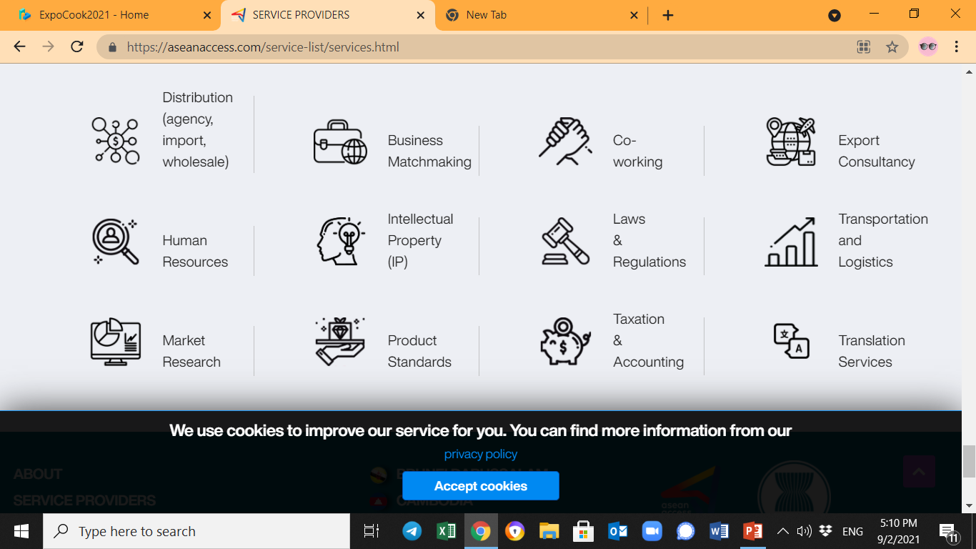
Who exactly are Service Providers?

Slide 6

Virtual business matchmaking
and
market access events

Slide 7
ADD ASEAN ACCESS MATCH VIDEO HERE

Slide 8
Key benefits (for event organisers and businesses):
Time and cost efficient
One-time registration
Unlimited events
Product and technology showcase
Growing business community
Free to use and participate

Slide 9
Questions?

Slide 10



Thank you
Terima Kasih
ကျေးဇူးတင်ပါတယ်
Brunei
Myanmar
សូមអរគុណ។
Salamat Sa Iyo
Cambodia
The Philippines
Terima Kasih
Thank you
Indonesia
Singapore
ຂອບໃຈ
ขอบคุณ
Lao PDR
Thailand
Terima Kasih
cảm ơn bạn
Malaysia
Viet Nam
www.aseanaccess.com

