Slide 1


Your Business Information Gateway to ASEAN and Beyond
ASEAN Access
&
ASEAN Access MATCH:
Introduction
Triin Udris
On behalf of
Office of SMEs Promotion, Thailand
15 June 2022

Slide 2
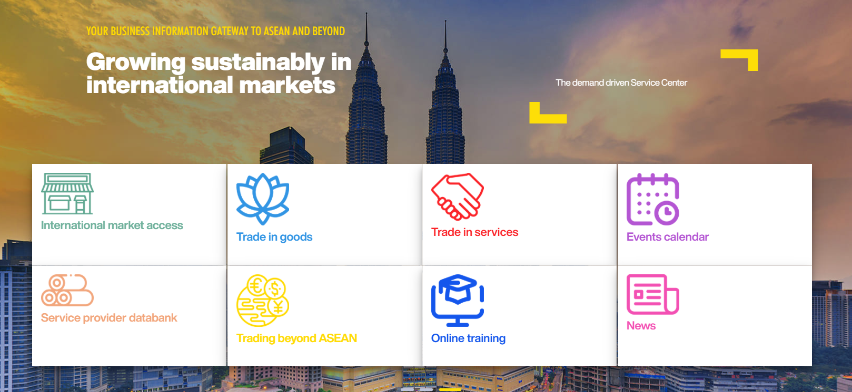
SME Internationalisation Support

Slide 3
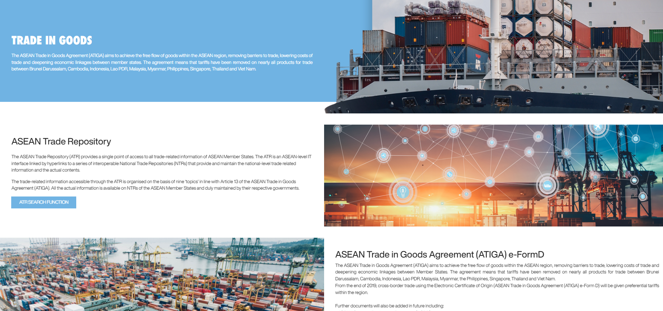
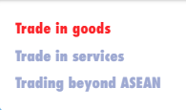
SME Internationalisation Support

Slide 4

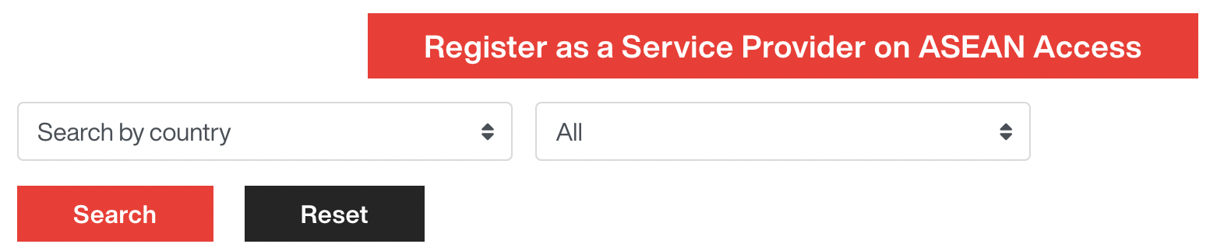
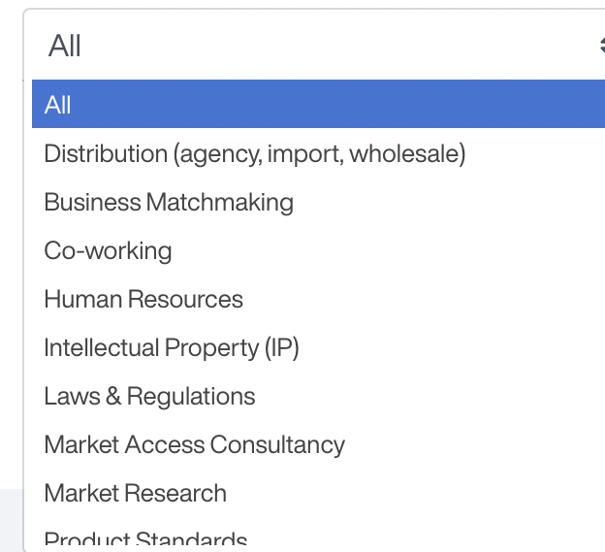
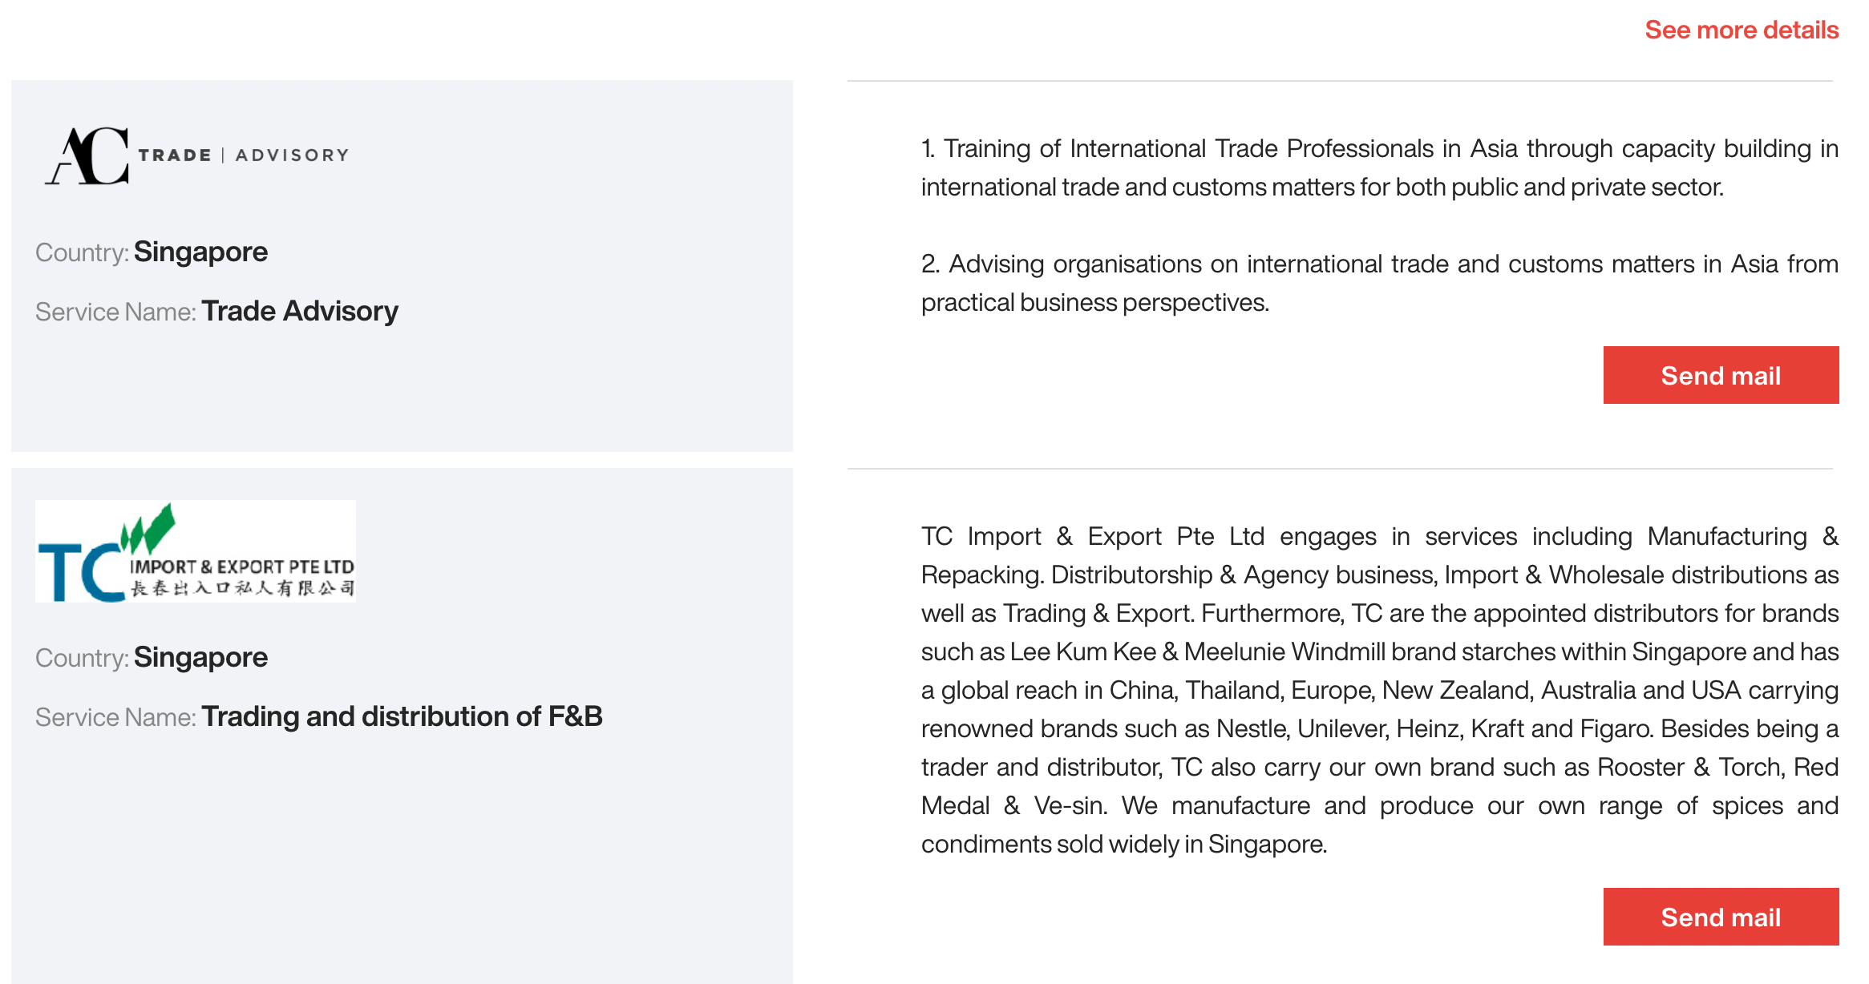
SME Internationalisation Support

Slide 5





SME Internationalisation Support
Sector brief on manufacturing
Sector brief on
digital/IT
Sector brief on
clean technology
Sector brief on
agriculture
Sector brief on
food and beverages

Slide 6

BUSINESS AND MATCHMAKING EVENTS

Slide 7
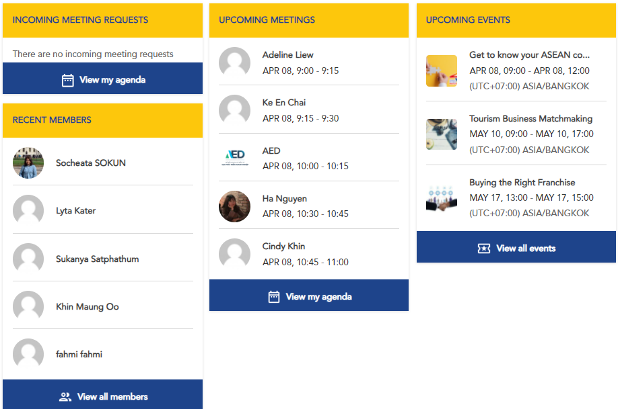

Slide 8
What are the advantages of ASEAN Access MATCH?
Long-term multi-event platform
One registration = lifetime access
Virtual business matchmaking events
Business community
Product / technology showcase
Who can use ASEAN Access MATCH?
Registered members (businesses) of ASEAN Access
Official partners of ASEAN Access (as organisers)

Slide 9

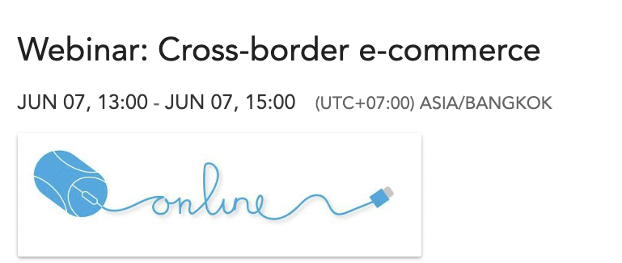


Upcoming Events

Slide 10
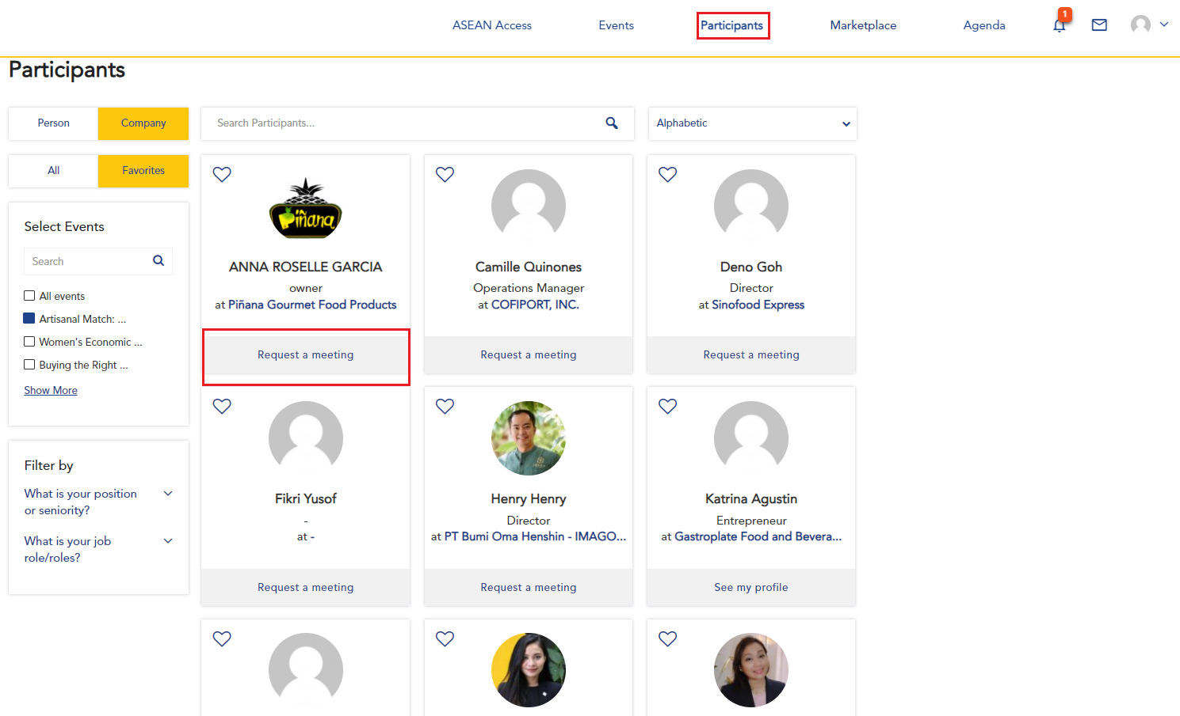

Slide 11
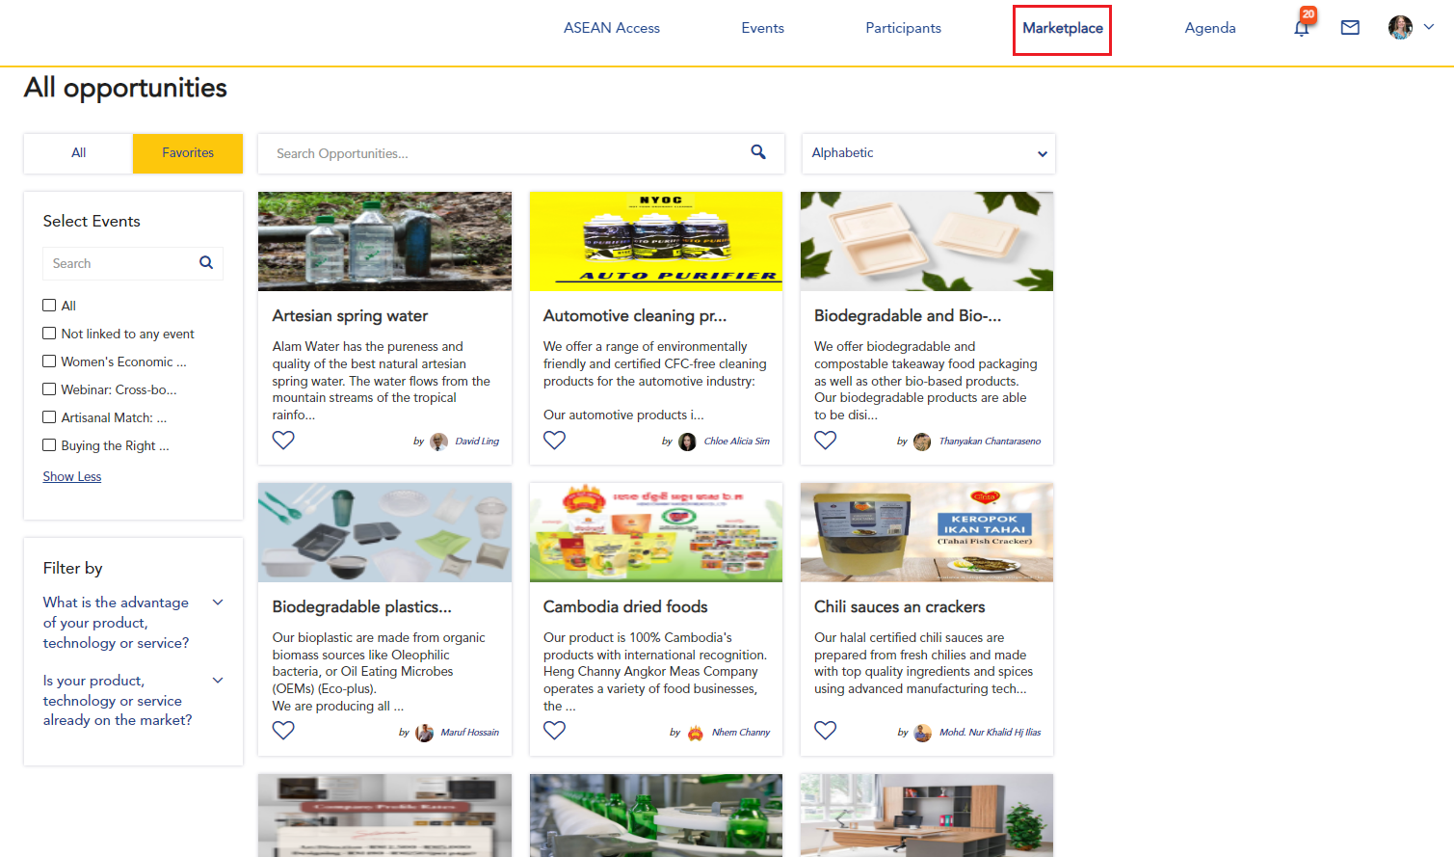

Slide 12

THE NETWORK

Slide 13




ASEAN Access:
Network Development, Outreach and promotion
Network Partner
NFP
Network Partner
Network Partner
Networks

Slide 14



























ASEAN Access: A Network

Slide 15














ASEAN Access: A Network

Slide 16



Thank you
Terima Kasih
ကျေးဇူးတင်ပါတယ်
Brunei
Myanmar
សូមអរគុណ។
Salamat Sa Iyo
Cambodia
The Philippines
Terima Kasih
Thank you
Indonesia
Singapore
ຂອບໃຈ
ขอบคุณ
Lao PDR
Thailand
Terima Kasih
cảm ơn bạn
Malaysia
Viet Nam
www.aseanaccess.com

