Slide 1


Your Business Information Gateway to ASEAN and Beyond
ASEAN Access:
Introduction
Triin Udris
on behalf of the Office of SMEs Promotion (OSMEP) of Thailand

Slide 2

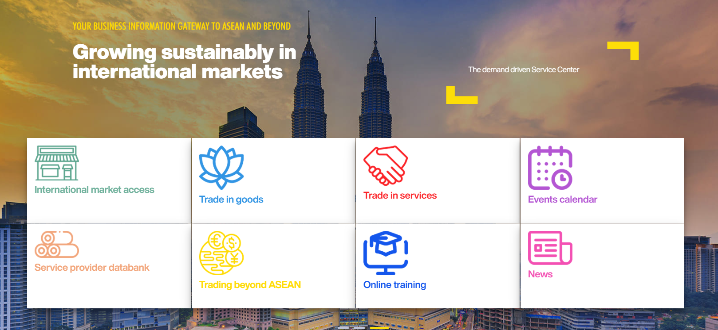
Internationalisation support

Slide 3



























ASEAN Access: A Network

Slide 4
















ASEAN Access: A Network

Slide 5

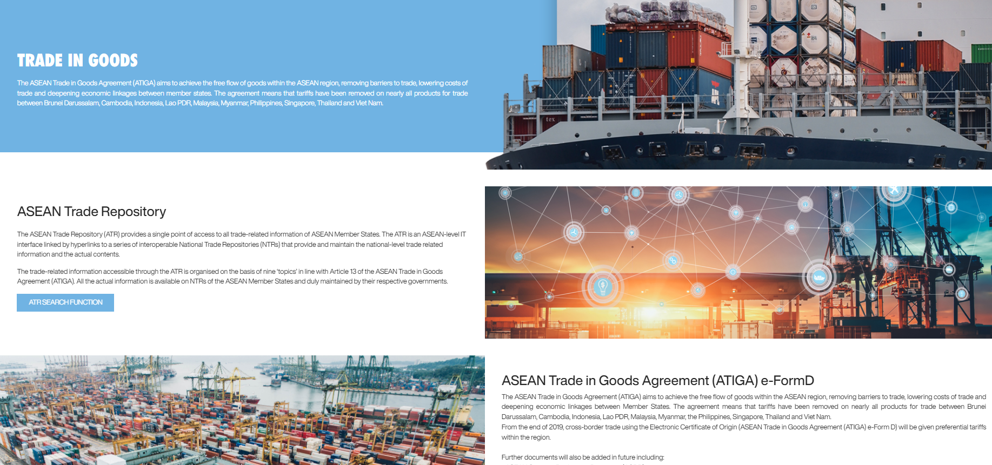
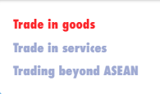
Internationalisation support

Slide 6

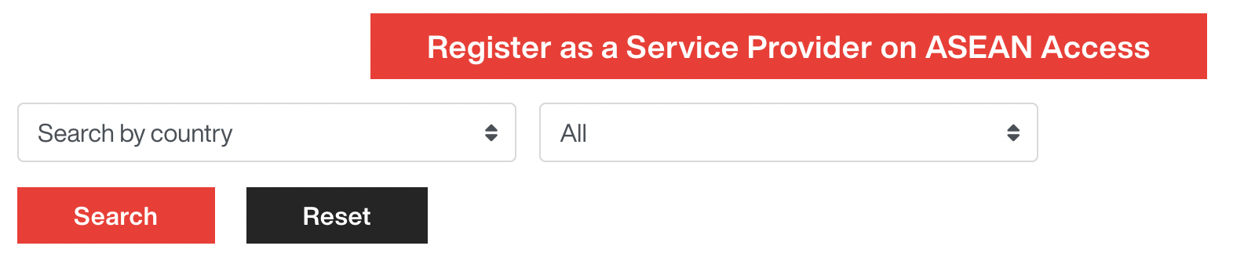
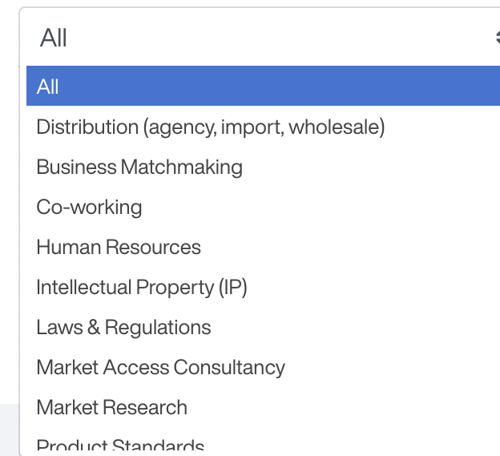
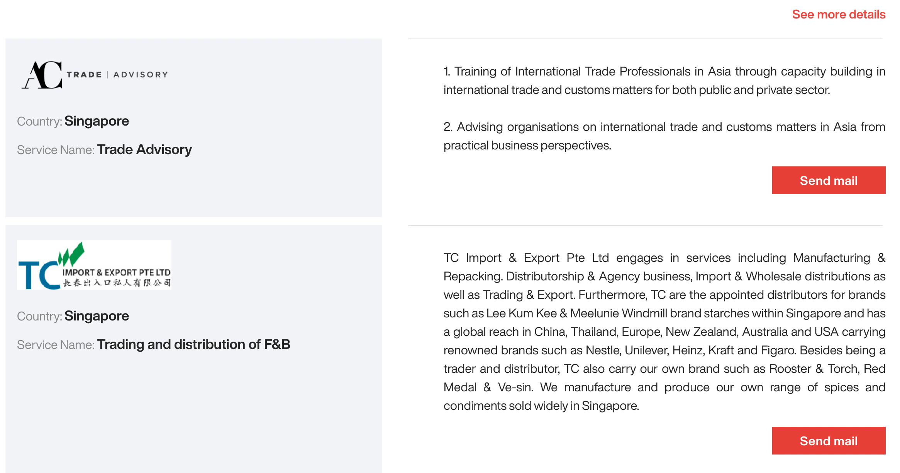
SME Internationalisation Support

Slide 7





Internationalisation support
Sector brief on manufacturing
Sector brief on
digital/IT
Sector brief on
clean technology
Sector brief on
agriculture
Sector brief on
food and beverages

Slide 8

BUSINESS AND MATCHMAKING EVENTS

Slide 9
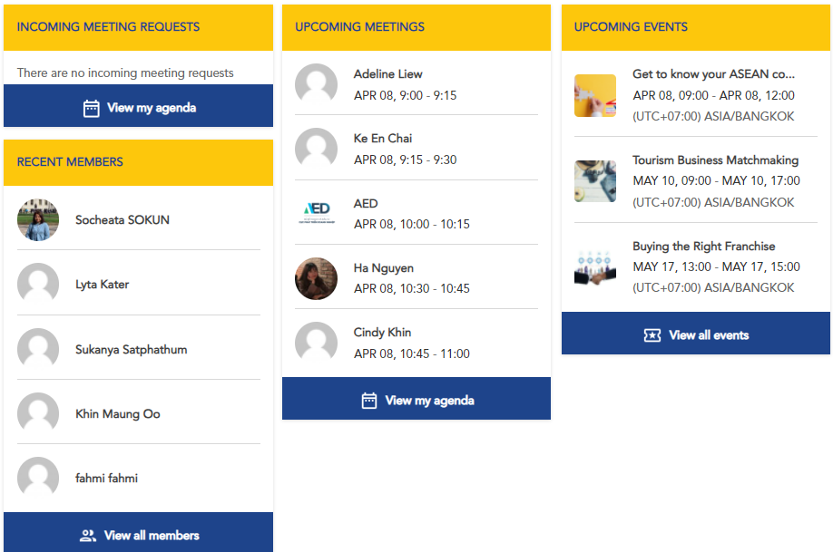

Slide 10
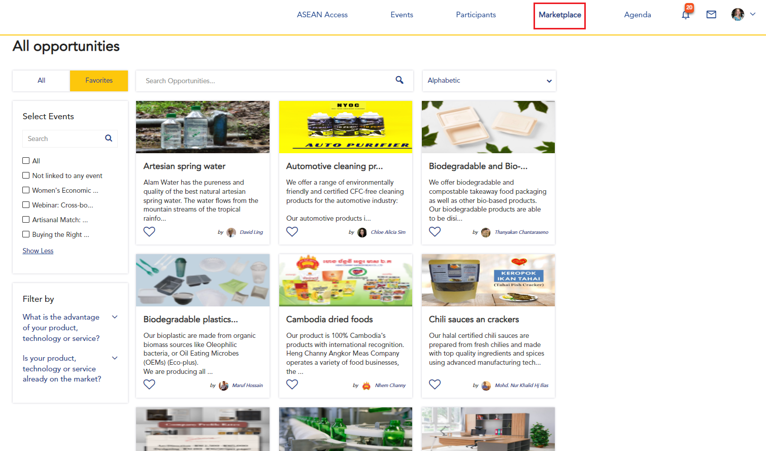

Slide 11
Internationalisation support
What are the advantages of ASEAN Access MATCH?
Long-term multi-event platform
Virtual business matchmaking
One registration = lifetime access
Growing business community
Product / technology showcase
Increased efficiency
Who can use ASEAN Access MATCH?
Registered members of ASEAN Access – free of charge
ASEAN Access Partners (organisers) – free of charge

Slide 12
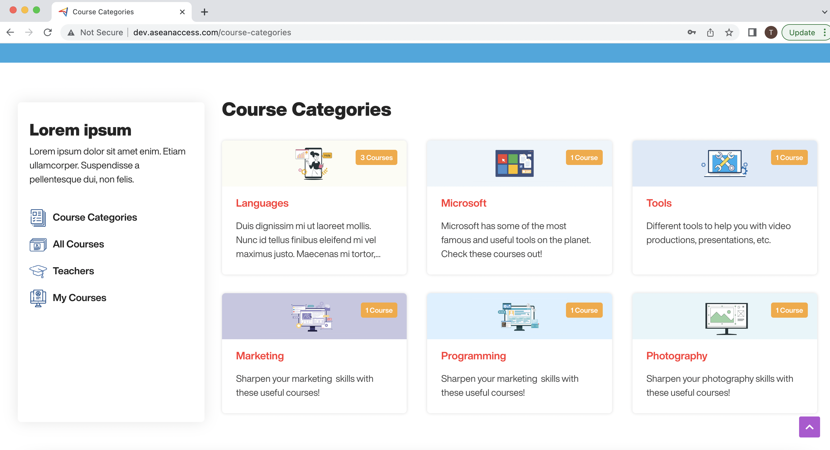


Slide 13

Cooperation: open invitation
Who should collaborate with ASEAN Access?
Why collaborate with ASEAN Access?
Public and private sector organisations
Offering internationalisation and business support
With a membership-base or easy access to businesses
Free use of ASEAN Access MATCH and LEARN
Access to a large regional network
Increased visibility and opportunities in the region
Notes:
.

Slide 14



Thank you
Terima Kasih
ကျေးဇူးတင်ပါတယ်
Brunei
Myanmar
សូមអរគុណ។
Salamat Sa Iyo
Cambodia
The Philippines
Terima Kasih
Thank you
Indonesia
Singapore
ຂອບໃຈ
ขอบคุณ
Lao PDR
Thailand
Terima Kasih
cảm ơn bạn
Malaysia
Viet Nam
www.aseanaccess.com

