Slide 1


Your Business information Gateway to ASEAN and Beyond
TITLE
Presenter name
Organisation
Date

Slide 2

ASEAN Access

Slide 3
Who should join ASEAN Access?
SMEs who are looking to internationalise and need advice, information and practical support and contacts in the new market
Businesses who have services and expertise that can help foreign SMEs enter the local market = Service Providers
NB! Service Providers are not companies interested in exporting their own products/brands

Slide 4
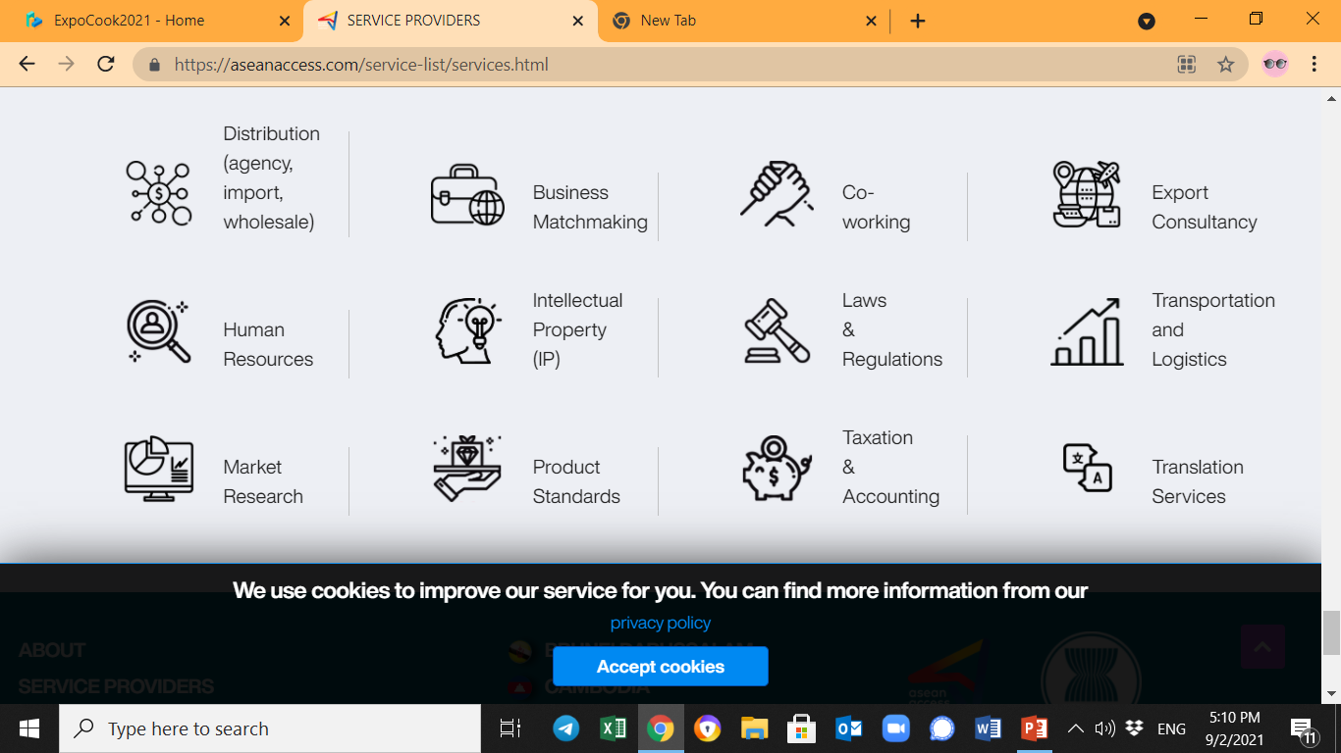
Who exactly are Service Providers?

Slide 5
Benefits for SMEs
Benefits for SMEs
Find Service Providers who can help you enter new markets
Download country profiles
Download sector briefs
Familiarise yourself with trade regulations
Browse an events and business matchmaking calendar
Stay up to date on regional business news
Participate in matchmaking, market information and other events

Slide 6
Benefits for Service Providers
Find new business opportunities and products
Increase your company visibility in ASEAN and the world
Download country profiles
Download sector briefs
Familiarise yourself with trade regulations
Browse an events and business matchmaking calendar
Stay up to date on regional business news
Participate in matchmaking, market information and other events

Slide 7
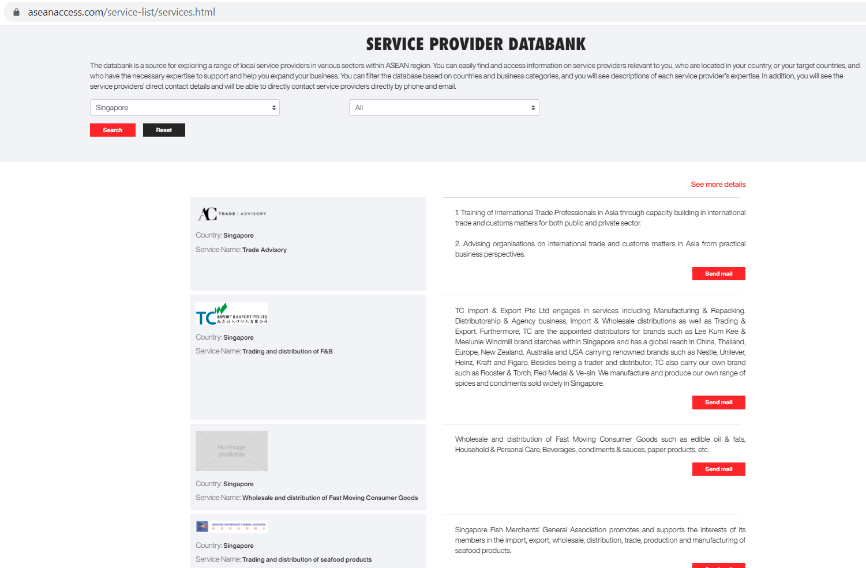

Slide 8





Sector briefs and country profiles
For all 10 ASEAN Member States
Sector brief on manufacturing
Sector brief on
digital/IT
Sector brief on
clean technology
Sector brief on
agriculture
Credit font: HelvetiNowDisplayMedium (14 pt)
Sector brief on
food and beverages

Slide 9
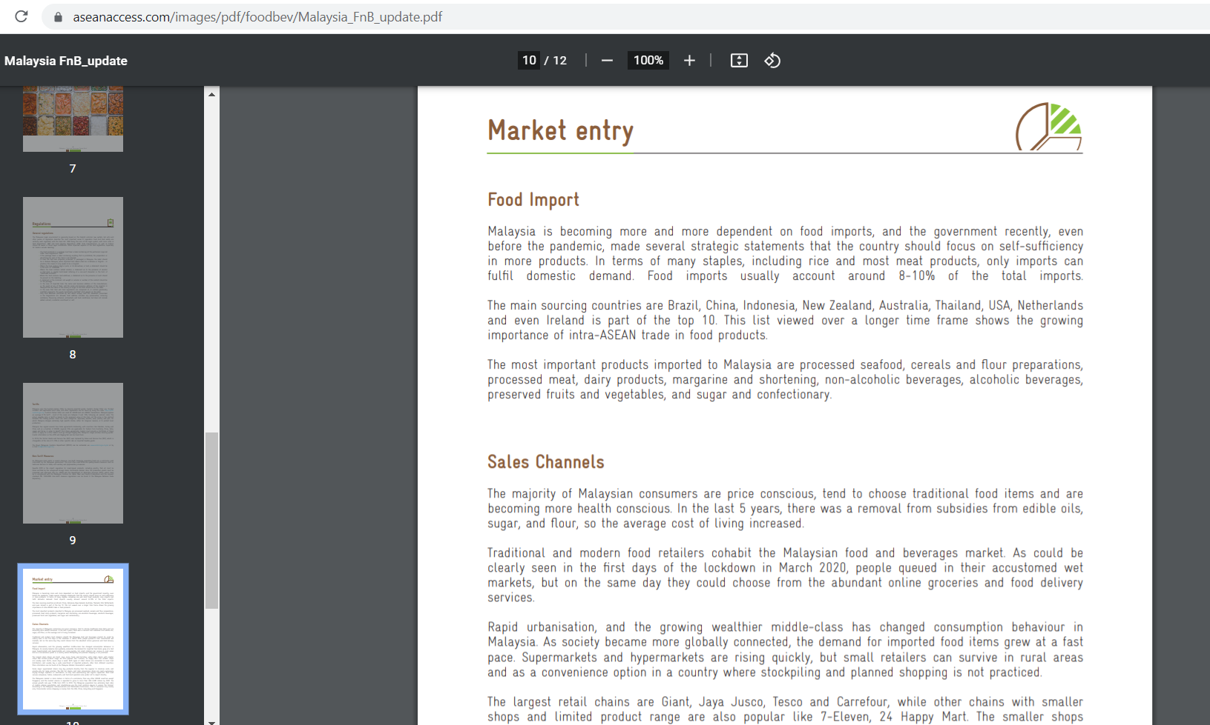

Slide 10
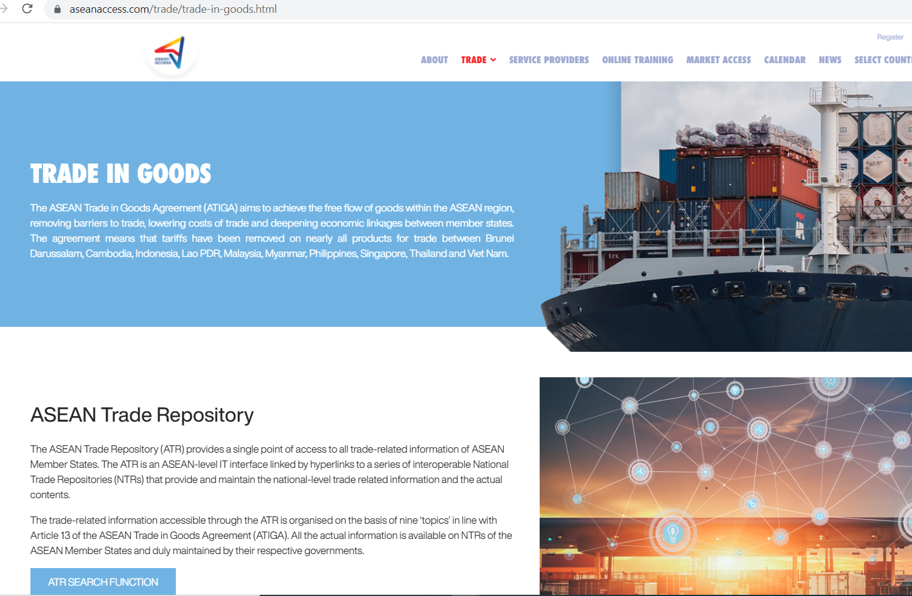


Slide 11
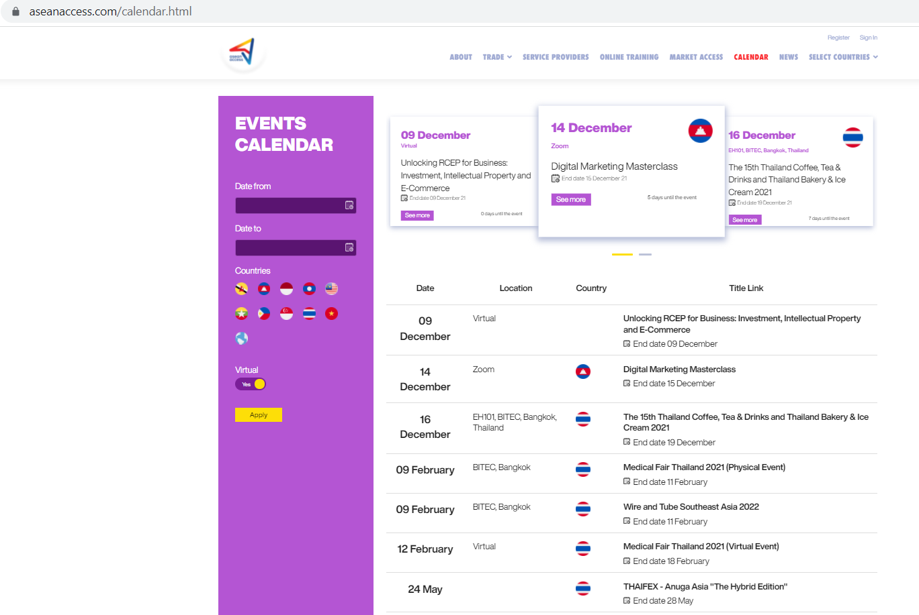

Slide 12
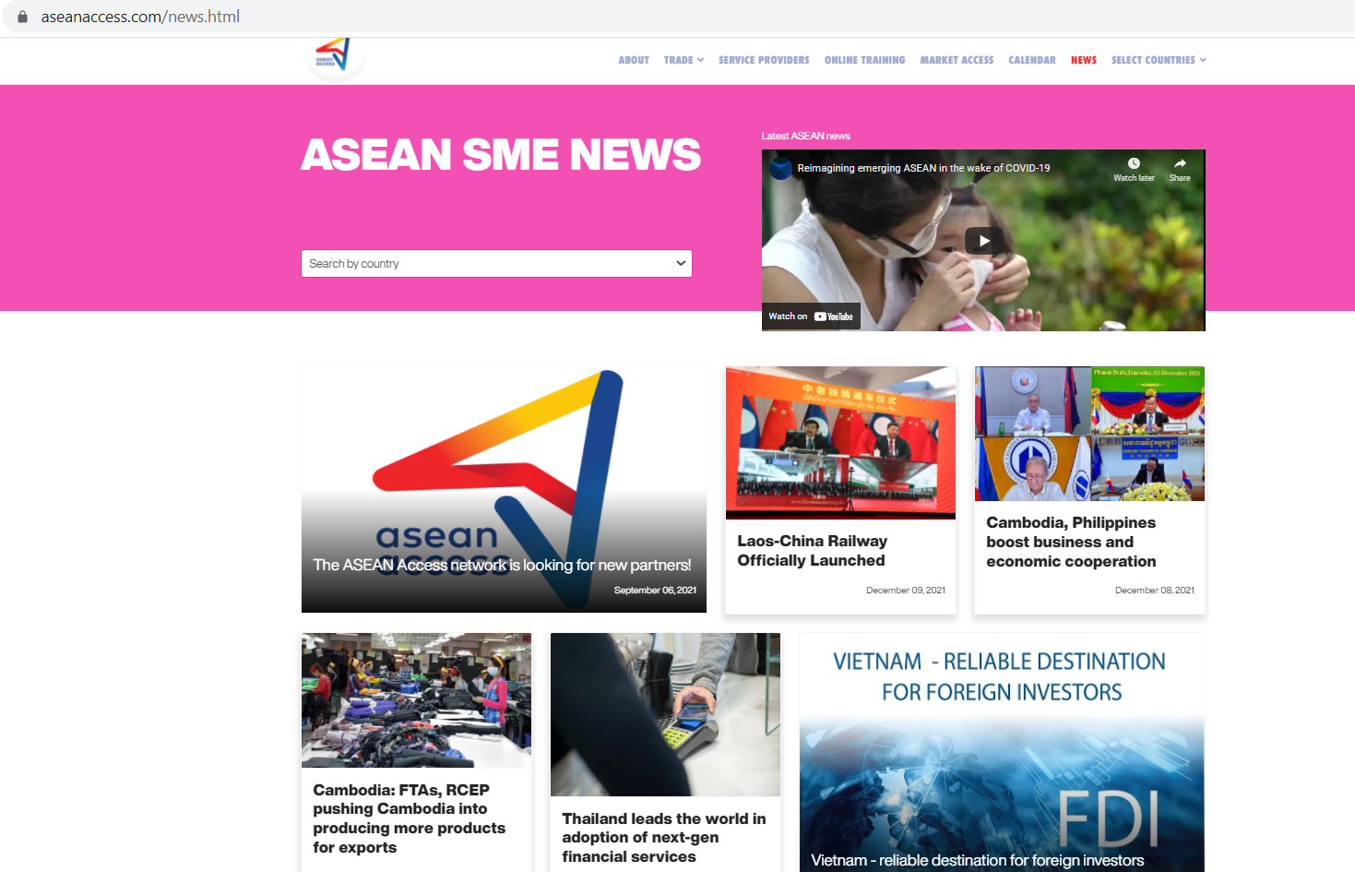

Slide 13
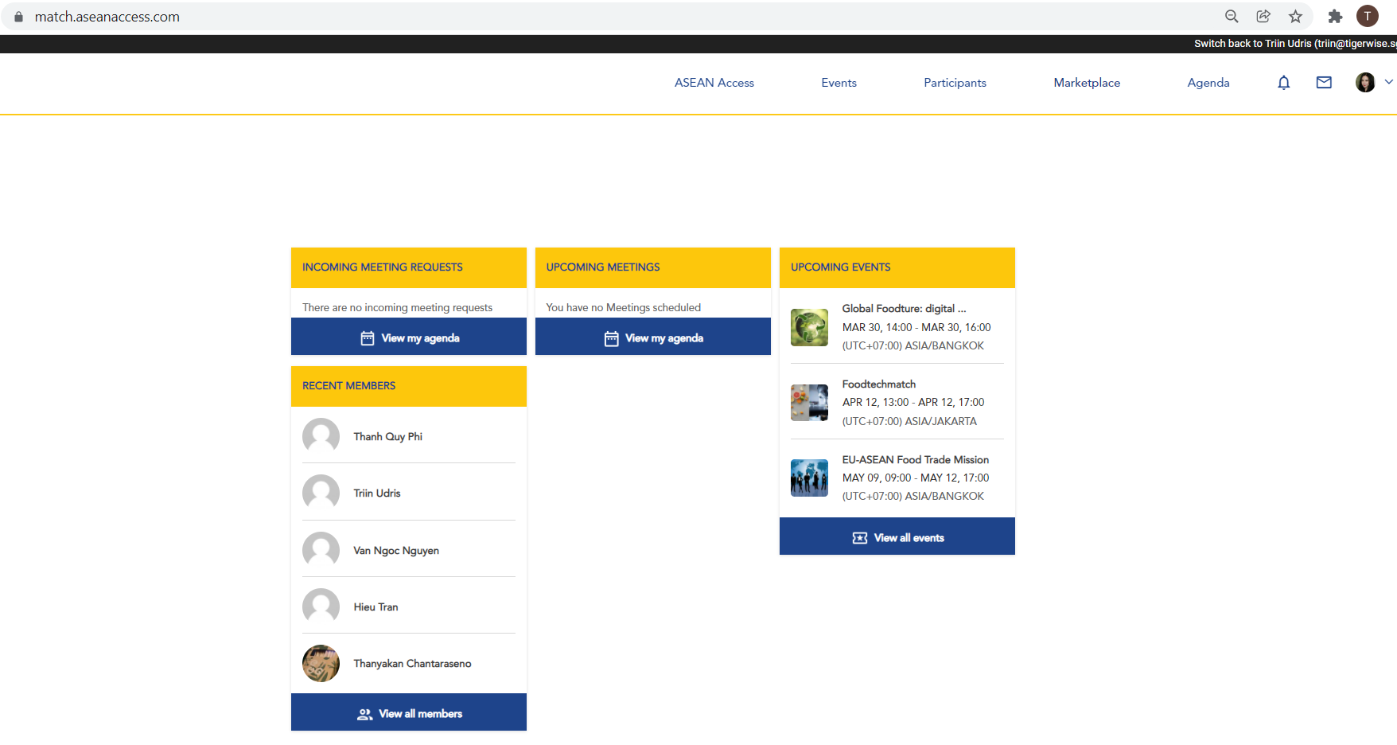

Welcome to ASEAN Access MATCH Business Community
For ASEAN Access registered members only!

Slide 14
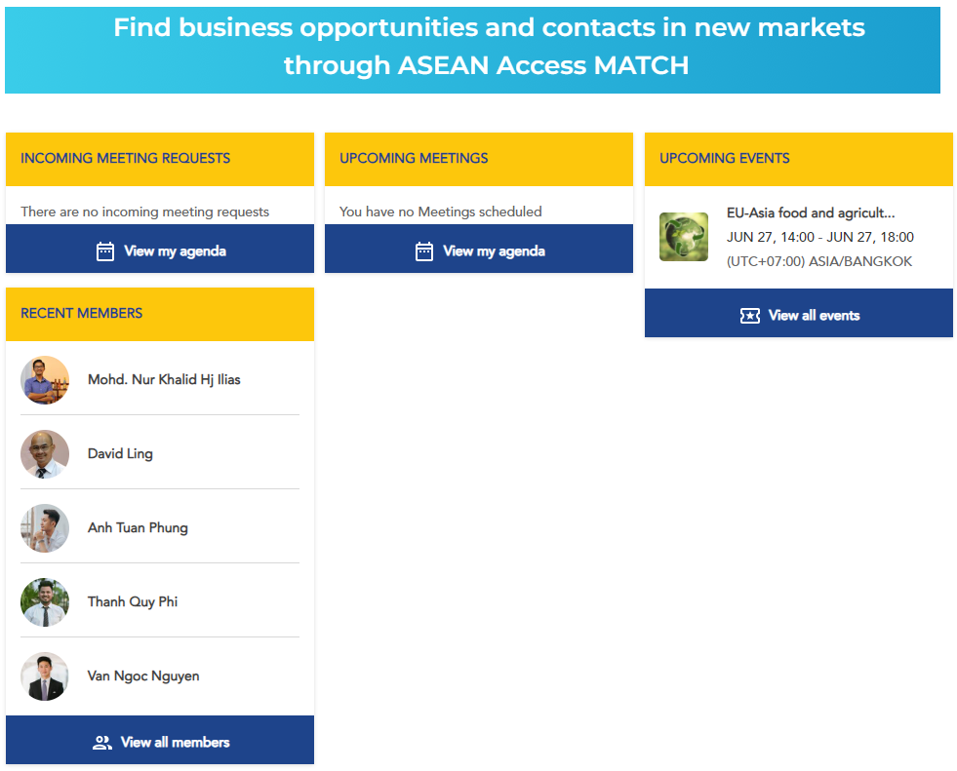
For ASEAN Access registered members only!

Slide 15

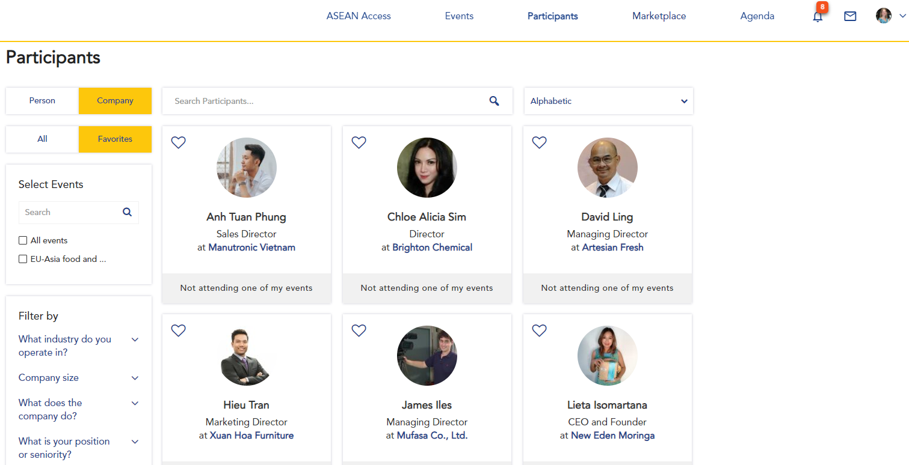
Business community

Slide 16
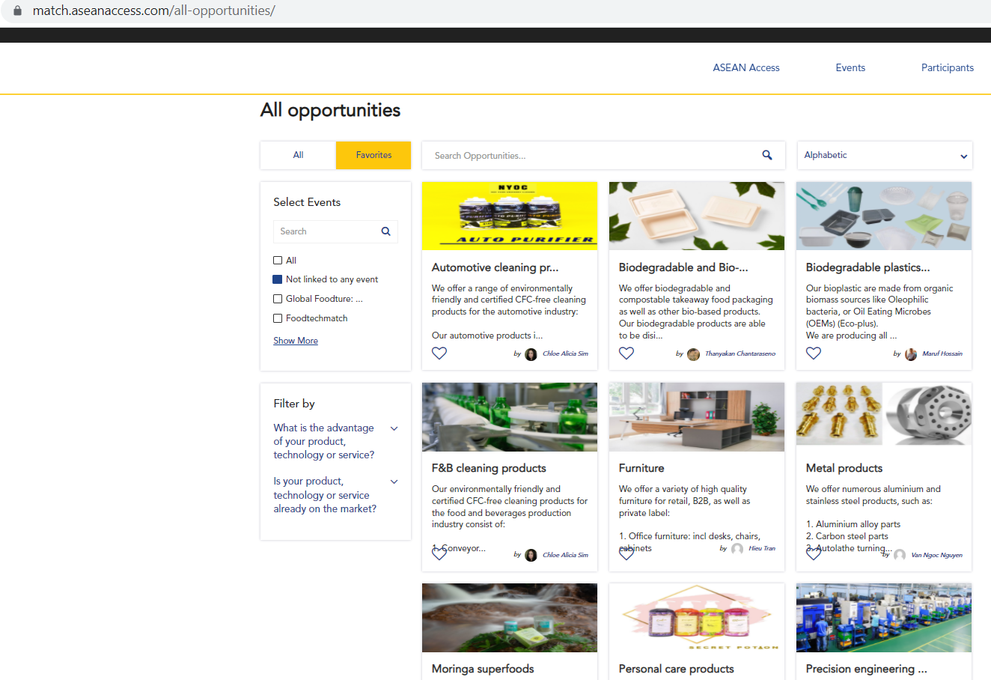
Product and technology showcase

Slide 17
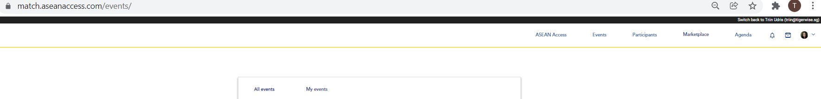



EVENTS AND MATCHMAKING

Slide 18
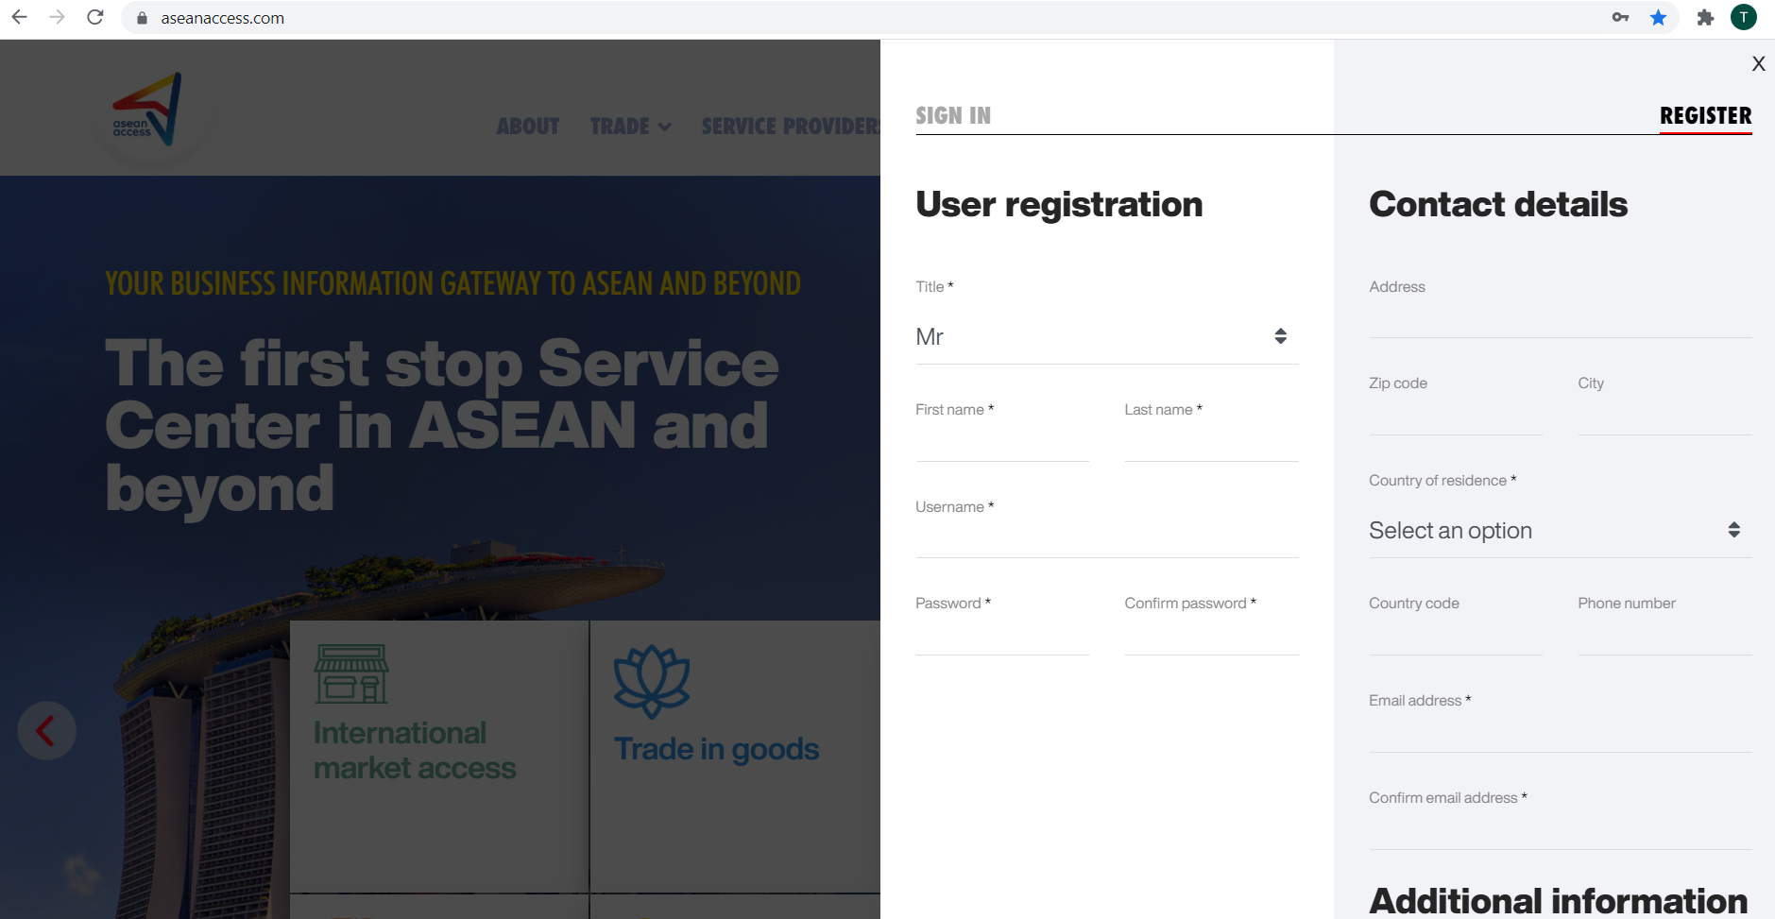
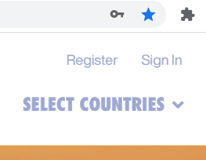

Slide 19
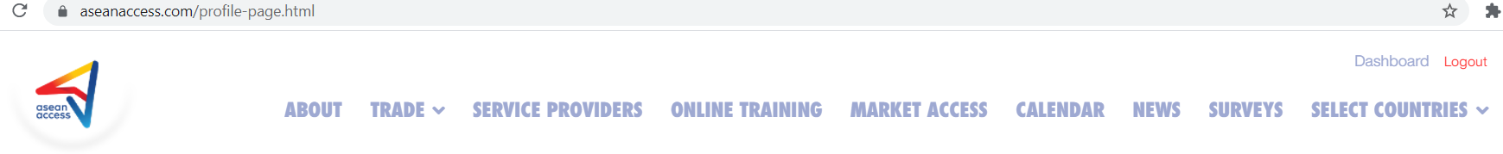
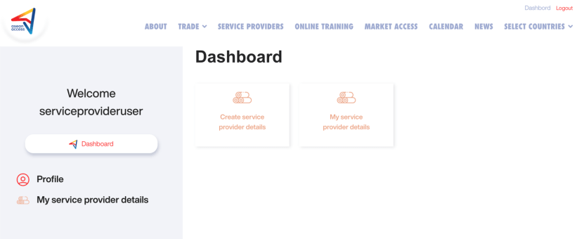

Slide 20
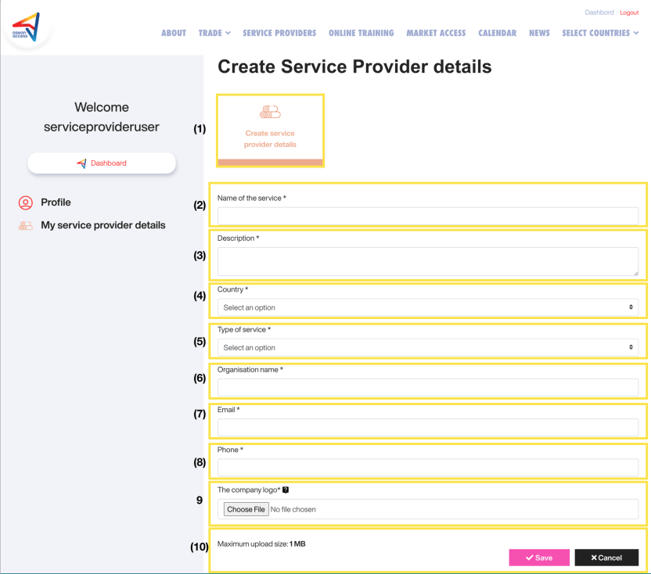
THAT’S IT!

Slide 21



Thank you
Terima Kasih
ကျေးဇူးတင်ပါတယ်
Brunei
Myanmar
សូមអរគុណ។
Salamat Sa Iyo
Cambodia
The Philippines
Terima Kasih
Thank you
Indonesia
Singapore
ຂອບໃຈ
ขอบคุณ
Lao PDR
Thailand
Terima Kasih
cảm ơn bạn
Malaysia
Viet Nam
www.aseanaccess.com

