Slide 1


Your Business Information Gateway to ASEAN and Beyond
ASEAN Access
&
ASEAN Access MATCH:
Introduction
Triin Udris
On behalf of
Office of SMEs Promotion, Thailand
18 July 2022

Slide 2
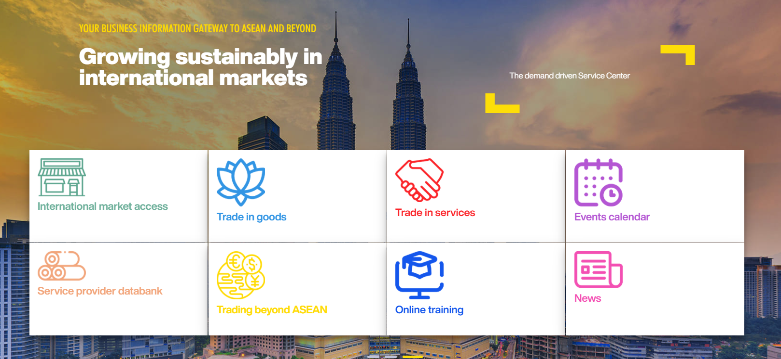
SME internationalisation support

Slide 3
Who should join/use ASEAN Access?
Businesses who want to internationalise and need advice, information, and practical support and contacts in the new market
Businesses who have services and expertise that can help foreign companies enter the local market = Service Providers

Slide 4
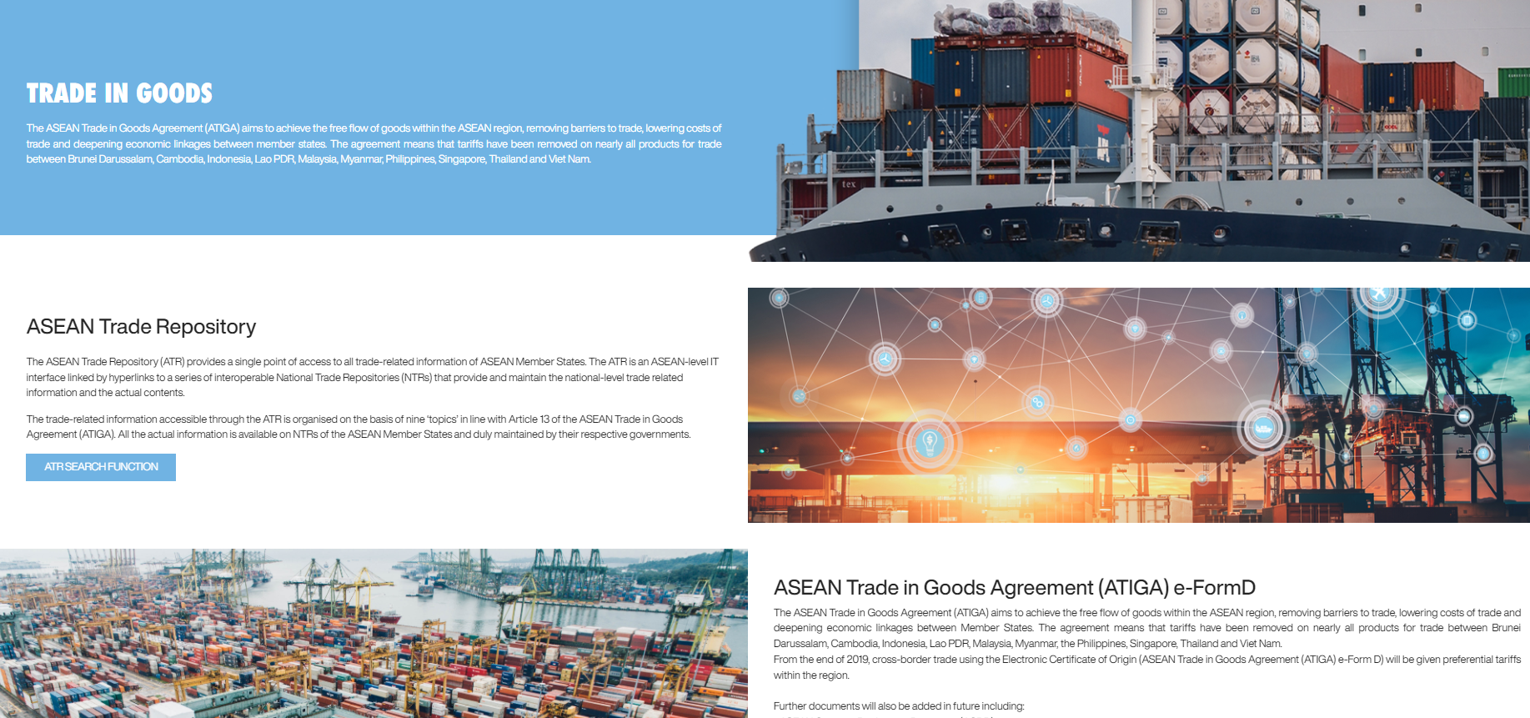
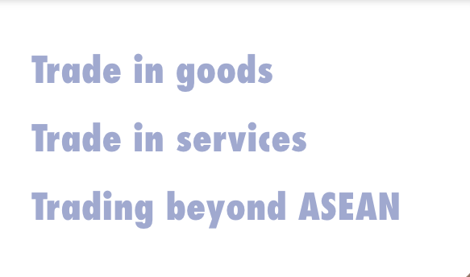
SME internationalisation support

Slide 5

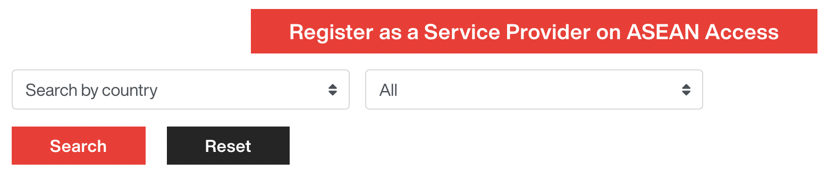
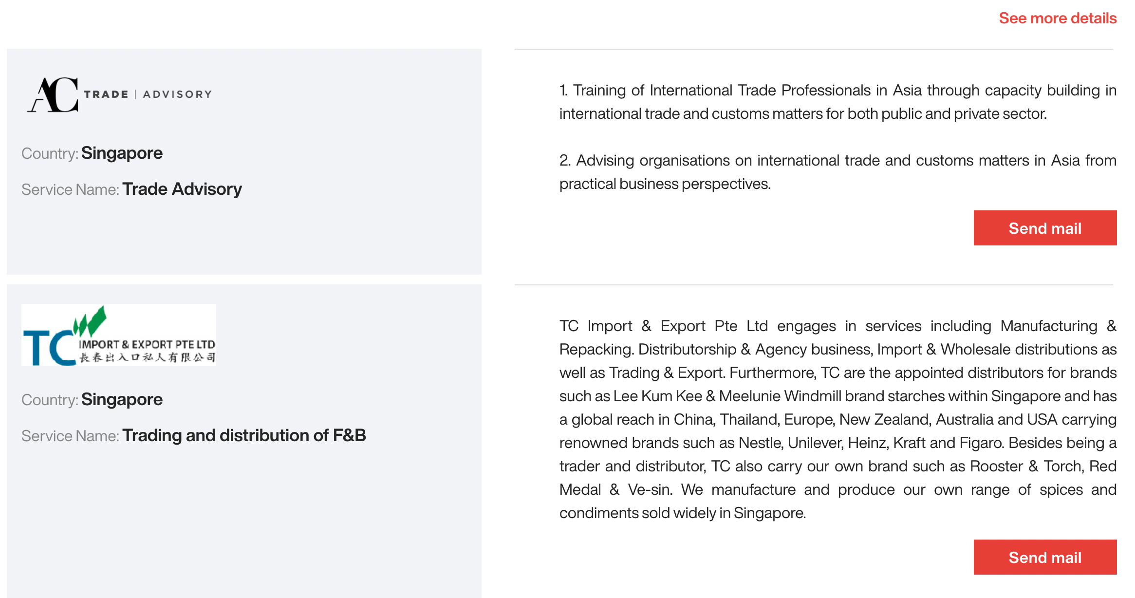
SME internationalisation Support

Slide 6
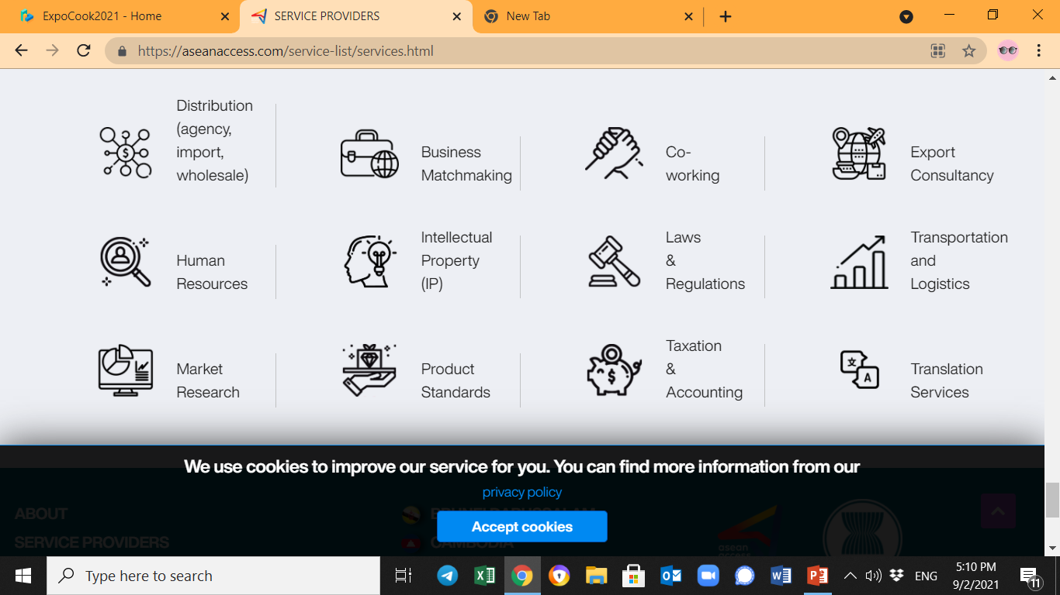
Which services are offered by Service Providers?
EXPORT

Slide 7
Why register as a Service Provider?
Would you like to promote your business, free of charge, to potential new international clients?

Slide 8



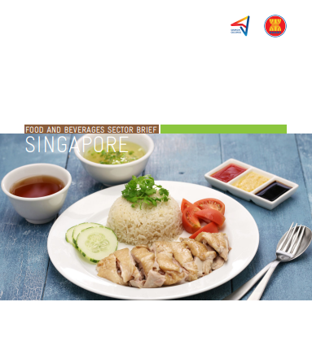

SME internationalisation support
Sector brief on manufacturing
Sector brief on
digital/IT
Sector brief on
clean technology
Easy to read, commercial focus
Business opportunities, growth areas
Base for expansion strategy
Sector brief on
food and beverages
Sector brief on
agriculture

Slide 9

BUSINESS AND MATCHMAKING EVENTS

Slide 10
What are the advantages of ASEAN Access MATCH?
Long-term multi-event platform
One registration = lifetime access
Virtual business matchmaking events
Business community
Product / technology showcase
Who can use ASEAN Access MATCH?
Registered members (businesses) of ASEAN Access
Official partners of ASEAN Access (as event organisers)

Slide 11
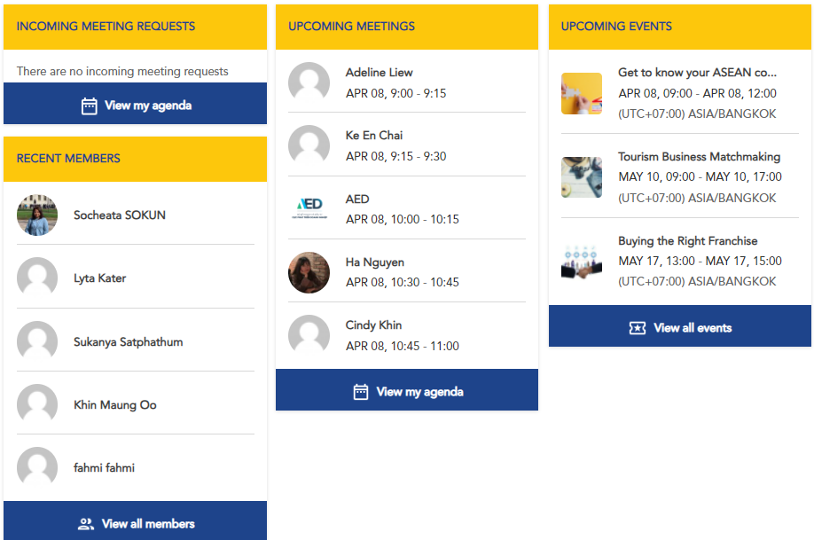

Slide 12

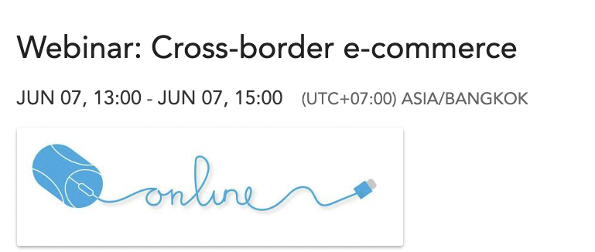
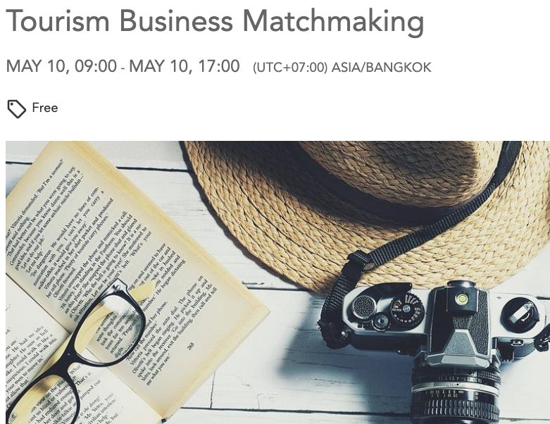

Snapshot of events

Slide 13
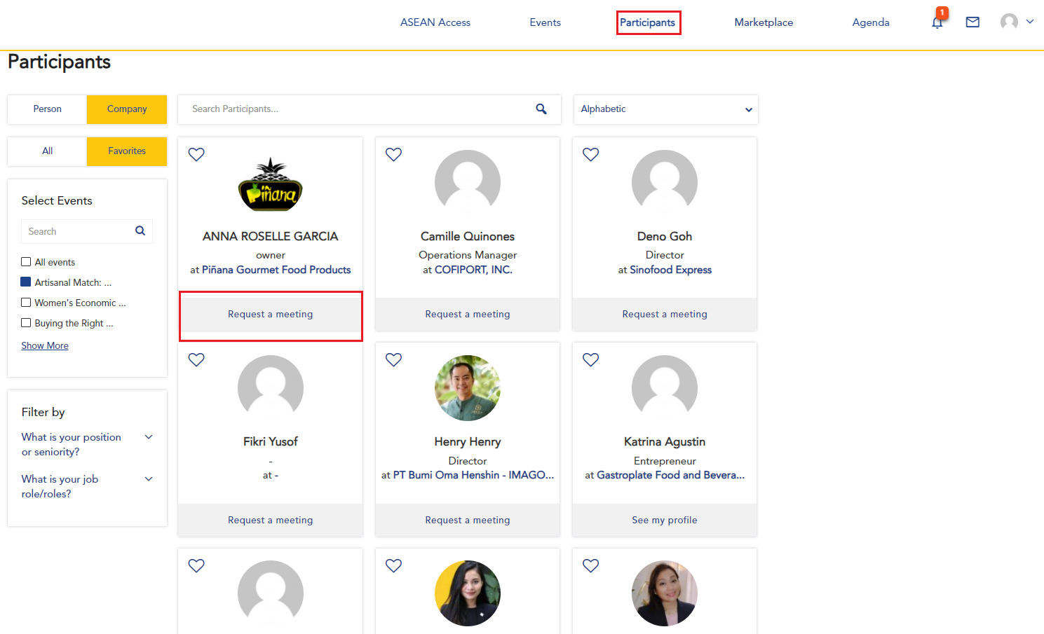

Slide 14
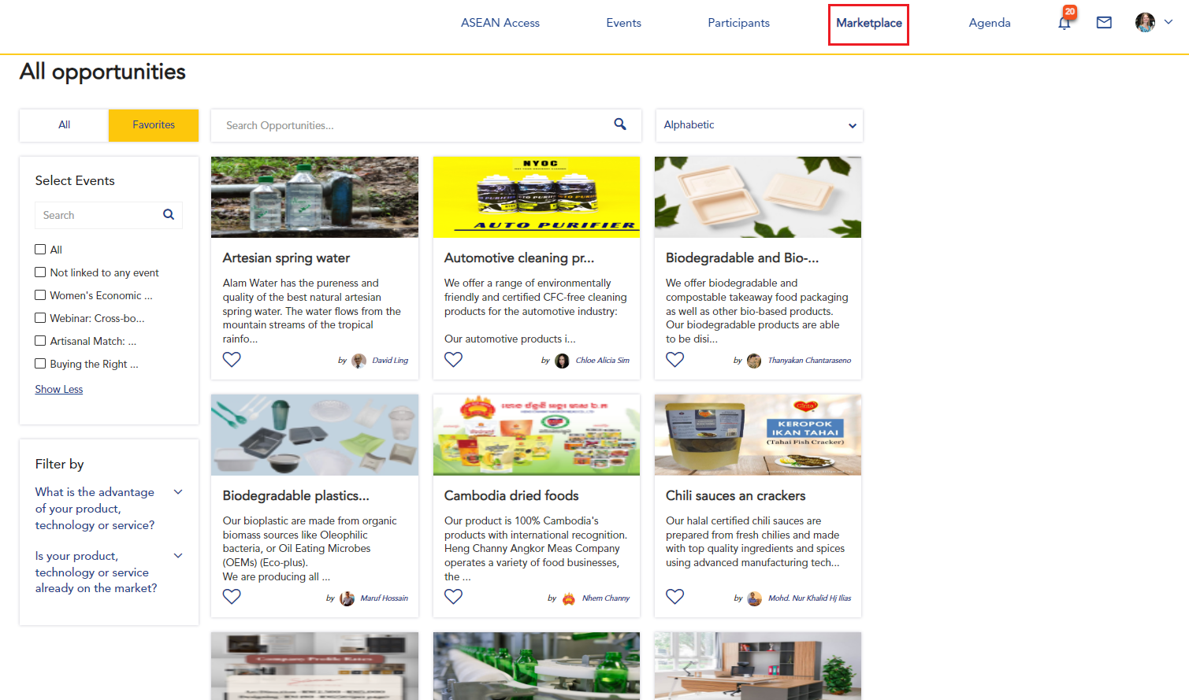

Slide 15
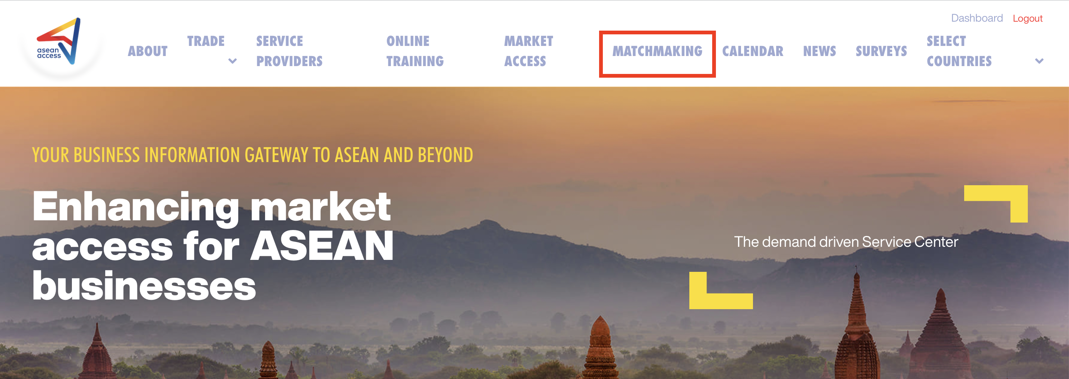
Registering for MATCH events
Double registration: ASEAN Access -> ASEAN Access MATCH

Slide 16

THE NETWORK

Slide 17



























ASEAN Access: A Network

Slide 18
















ASEAN Access: A Network

Slide 19



Thank you
Terima Kasih
ကျေးဇူးတင်ပါတယ်
Brunei
Myanmar
សូមអរគុណ។
Salamat Sa Iyo
Cambodia
The Philippines
Terima Kasih
Thank you
Indonesia
Singapore
ຂອບໃຈ
ขอบคุณ
Lao PDR
Thailand
Terima Kasih
cảm ơn bạn
Malaysia
Viet Nam
www.aseanaccess.com

