Slide 1


Your Business information Gateway to ASEAN and Beyond
ASEAN Access:
Welcome to Network Partners
Presenter
Organisation
Date

Slide 2
Agenda
01
Promotion of ASEAN Access
02
Recruiting registered members
03
Adding news and events
04
Using MATCH

Slide 3
 | No progress |  | KPI<50% |  | KPI= / >50% |  | KPI=100%
Indicator | Total ASEAN target 2022 (total combined 2021-2022) | Brunei Darussalam | Cambodia | Indonesia | Lao PDR | Malaysia | Myanmar | The Philippines | Singapore | Thailand | Viet Nam | TOTAL: ASEAN end of 2022 As of 3 December 2021
Unique visitors to the portal | 25,000 |  |  |  |  |  |  |  |  |  |  | 21,200
Registered members | 2000 |  |  |  |  |  |  |  |  |  |  | 878
Active registered members | 500 |  |  |  |  |  |  |  |  |  |  | 750
Validated SP (those not registered as distributors or matchmakers) | 1000 | 9 | 8 | 2 | 6 | 20 | 1 | 27 | 8 | 32 | 16 | 129
Validated distributors | 80 | 2 | 1 | 5 | 0 | 7 | 0 | 0 | 16 | 6 | 0 | 37
Validated matchmakers | 20 | 0 | 3 | 0 | 2 | 11 | 0 | 16 | 1 | 10 | 2 | 45
Number of news (per country) | 3 / month | 0 | 0 | 0 | 0 | 0 | 0 | 0 | 0 | 0 | 0 | 0
Number of events (per country) | 12 | 0 | 0 | 0 | 0 | 0 | 0 | 0 | 0 | 0 | 0 | 0
National NFP and TF meetings (per country) | 3 | 0 | 0 | 0 | 0 | 0 | 0 | 0 | 0 | 0 | 0 | 0
International cooperation partners | 4 |  |  |  |  |  |  |  |  |  |  | 0

Slide 4
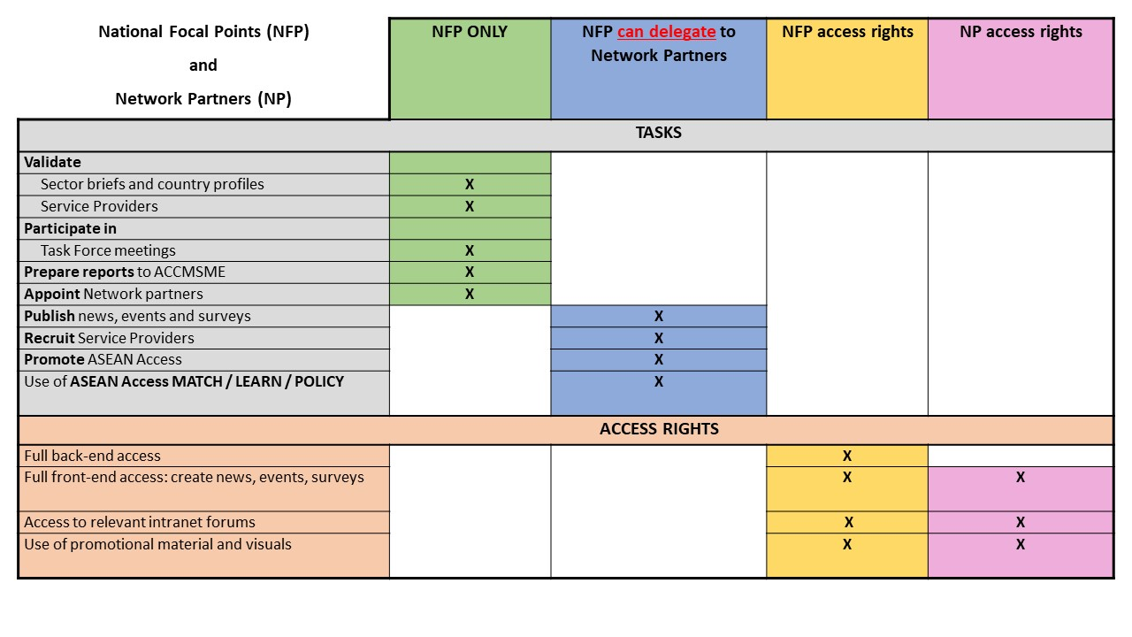

Slide 5
1. Promoting ASEAN Access
AIM: attract visitors to ASEAN Access website (incl. companies that might register on AA) and generally promote the portal on the national level
Network Partners can use ALL available materials and visuals in the forums document storage:
- logos
- outreach paper (very useful!)
- flyers
- social media posts (follow ASEAN Access Facebook page)
- user manuals
- etc.
TO DO – create Network Partner user accounts: need first name / surname (general front end access)

Slide 6
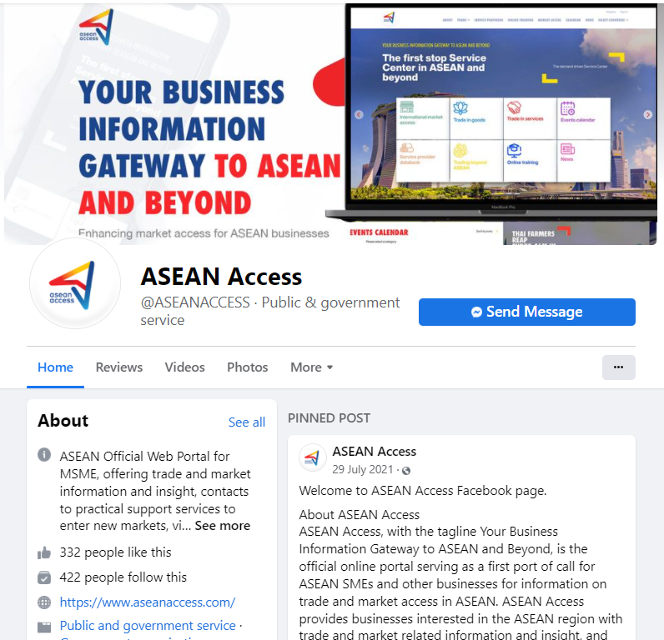
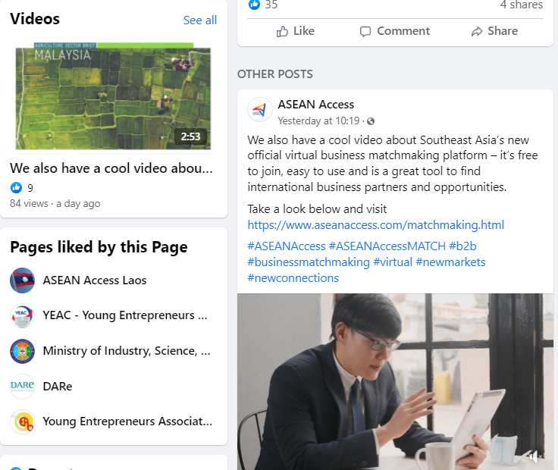
ASEAN Access social media
Notes:
.

Slide 7
Recruiting registered members of ASEAN Access
WHO WILL USE ASEAN ACCESS?
SMEs who are looking to internationalise and need advice, information and practical contacts in the new market (normal users)
Businesses who have services and expertise that can help foreign SMEs enter the local market = Service Providers (SP)
(Thai SME -> Malaysian SP ->Thai SME enters or receives support on the Malaysian market)
Service Providers are not companies interested in exporting their own products/brands

Slide 8
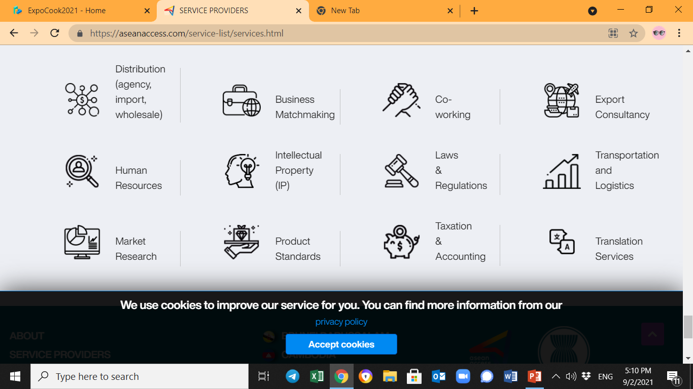


2. Recruiting Service Providers (SP)
SP are companies or organisations that can offer registered members of ASEAN Access the services that relate to entering new markets e.g., help a foreign company enter SP domestic market (help a Thai company sell products, technologies or services, set up a business in Myanmar, understand the local market etc.)
Companies who buy products from abroad / Agents
NOT manufacturers or exporters
Buyers
Sellers
Companies or organisations who can introduce or “match” businesses with each other
= B2B

Slide 9
3. Adding news and events
Key points:
News as foreign business attraction tool
Not a promotion of a single company
Internationalisation and international trade related
In English
Include the source
Author should have the right to use any images in the news
Events also internationally themed
Open to companies from more than one country
Instructions also on the “Create news” and “Create events” pages

Slide 10

4. Using MATCH
Free to use for all Network Partners to organise unlimited matchmaking and market information events.
Matchmaking requirements: between NFP and/or NP, minimum 2+ countries, internationalisation theme, preferably free of charge.
Webinars, conferences, trainings: open to companies from different countries, internationalisation theme, delivered in a common language, preferably free of charge.
Log in with the test account and show around: https://match.aseanaccess.com/login/

Slide 11
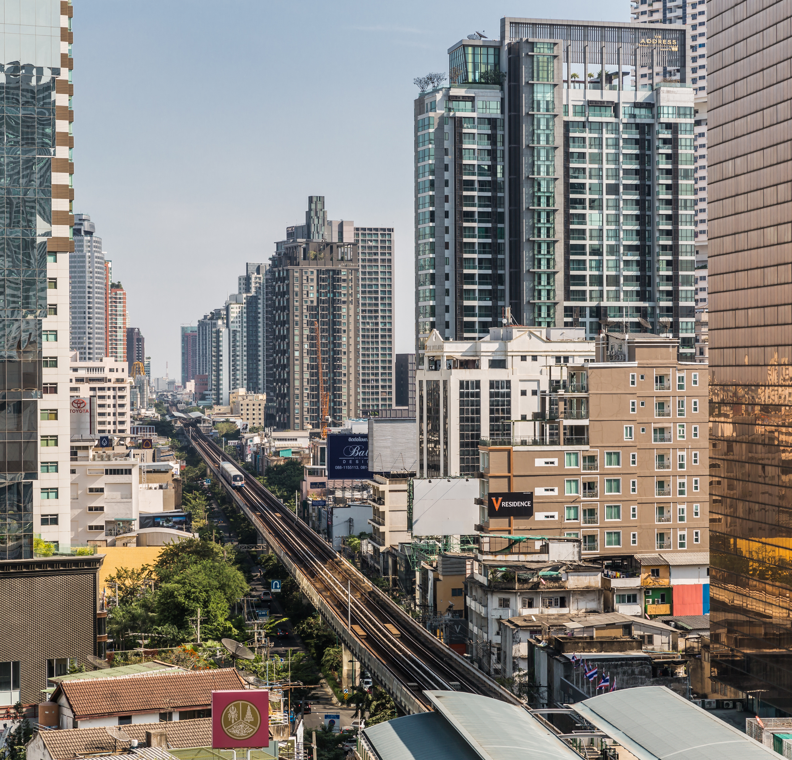


Thank you
Terima Kasih
ကျေးဇူးတင်ပါတယ်
Brunei
Myanmar
សូមអរគុណ។
Salamat Sa Iyo
Cambodia
The Philippines
Terima Kasih
Thank you
Indonesia
Singapore
ຂອບໃຈ
ขอบคุณ
Lao PDR
Thailand
Terima Kasih
cảm ơn bạn
Malaysia
Viet Nam
www.aseanaccess.com

